Slide 1
Value Representations
“There are 10 types of people in the world:
Those that know binary, and those that don’t.”
CS274
Prof. Ann Marie V. Schilling

Slide 2
Base Representation of Values
We are used to representing values in the decimal, or base 10 system. For instance when you look at the number 425, you say “Four Hundred Twenty Five”.
When you were first learning your numbers, you may have broken this number down into the hundreds place, tens place, and ones place.
You have four hundreds, two tens, and five ones

Slide 3
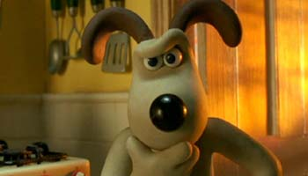
Looking closer at the decimal system
Hundreds place, Tens place, Ones place…
Decimal system…..
What do the values of the “places” have to do with the name “decimal” system?

Slide 4
Decimals Decoded!
Ones Place 10⁰
Tens Place 10¹
Hundreds place 10²
Decimal numbers are “Base 10” as the place values are 10 to some power
To decipher the value of 425 we have
4*10² + 2*10¹ + 5*10⁰

Slide 5
Representing Values in a Computer
At the lowest level, computers are made of circuits.
Circuits store signals in an assembly of components such as diodes, resistors, capacitors, etc…
These signals are very simple: They are either On or Off aka High or Low, True or False, 1 or 0

Slide 6
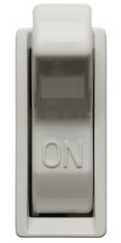
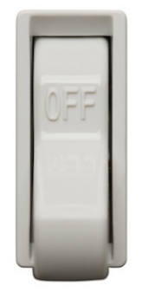
Representing Values in a Computer
Think about this…
Light switch stores one of two values:
One switch, two values
or On = 1
Off = 0

Slide 7
Limitations of One Switch
A light switch stores data, but it only stores one value.
A computer stores much more than 1 value!
How does a computer store tens of thousands of values? (or more?)

Slide 8
How do we represent more values?
More Switches!
0 0
0 1
1 0
1 1

Slide 9
Now lets assign values:
0 0 = 0 = 1
= 2 =3
0 1
1 0
1 1

Slide 10
Representing Values
The more switches, the larger the range of values we can hold.
1 switch: range [0,1]
2 switches: range [0,3]
…
n switches: range [0, 2^{n}-1]

Slide 11
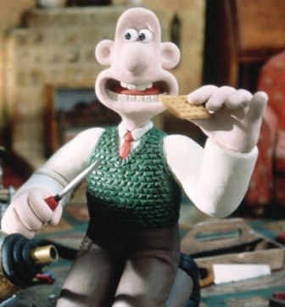
Representing Values
One switch holds a very small amount of information, in fact so small that we call it a bit of information.
A sequence of eight bits is called a byte
ex:
10010010
11001101

Slide 12
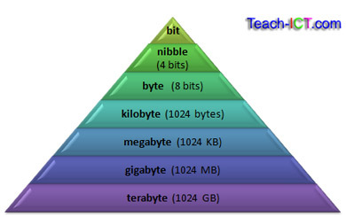
Bits, Nibbles, Bytes, and beyond
https://priestlandscomputing.com/units/

Slide 13
Digits and Ranges
For any base n:
Digits in this base are [0,n-1]
Values represented in r digits range on [0,n^{r}-1]
ie. In base 10, digits are [0,9] and the values represented in 2 digits are [0,99]

Slide 14
Binary: Base 2
https://ciscoiseasy.blogspot.com/2010/11/lesson-26-binary-world.html
In binary, there are “places” just as in decimal, except the places are values of 2 instead of 10.
Ones Place 2⁰
Twos Place 2¹
Fours Place 2²
Eights Place 2³ Etc….
To decipher the value of 1101_{B} we have:
1*2³ + 1*2² + 1*2⁰ =8+4+1=13

Slide 15
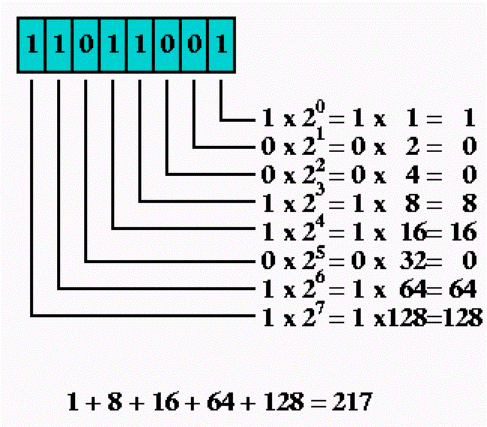
Another Binary Conversion
11011001_{B} = 217_{D}
http://javarevisited.blogspot.com/2015/01/how-to-convert-binary-number-to-decimal.html

Slide 16
Neat Binary Trick
To multiply a binary number by two, shift all bits left, shifting in a zero:
1100_{B} = 12_{D}
11000_{B} = 24_{D}
To divide a binary number by two, shift all bits right, filling in with a zero:
1010_{B} = 10_{D}
0101_{B} = 5_{D}

Slide 17
Tell me:
What is the range of values for 8 bits? 3 bits?
How can you tell if a binary number is odd? Even?
What kinds of restrictions do we have using the binary representations that you’ve seen so far?

Slide 18
A Note: Endian-ness
The terms “big-endian” and “little-endian” describe the location of the most significant bit (msb) or, the bit that has the highest value.
We will be using big-endian representation for this class. Therefore, in the byte 11001001_{B}, the bit with the highest value is the leftmost bit. Its value is 2⁷, or 128.
You may see little-endian representations further in your career.

Slide 19
Endian-ness
Most
Significant
Little Endian
BYTE 0 | BYTE 1 | BYTE 2 | BYTE 3
Big Endian
BYTE 3 | BYTE 2 | BYTE 1 | BYTE 0
Most
Significant

Slide 20
Hexademical: Base 16
Digits: What would be the range of digits for Base 16?
We know the range of digits for Base n is [0, n-1]
Therefore, digits for hex would be [0,15]
Digits for hex? 0, 1, 2, 3, 4,5, 67, 8, 9….wha? A digit can only be one character. What do we do?

Slide 21
Hexadecimal: Base 16
We use letters!
Digit Set for hex: {0,1,2,3,4,5,6,7,8,9, A, B, C, D, E, F}
A=10 B=11
C=12 D=13
E=14 F=15
We often see hex numbers represented:
0xAF6E or AF6E_{H}

Slide 22
Why Hex?
Hexadecimal numbers (usually shortened to “hex”) are used as a happy medium between computers and humans.
Why? Humans are better at reading shorter sequences of characters, computers prefer ones and zeroes.

Slide 23
Common Hex Uses
Used for color codes:
http://htmlcolorcodes.com/
Addressing:
0xFFA5
An interesting reference:
http://college.cengage.com/coursemate/technology_education/andrews_9781435497788/unprotected/book_level/The_Hexadecimial_Number_System_and_Memory_Addressing.pdf

Slide 24
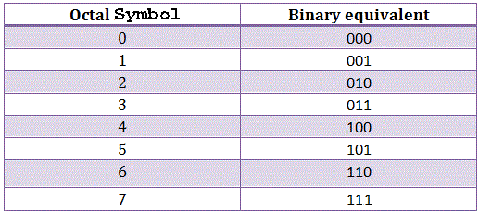
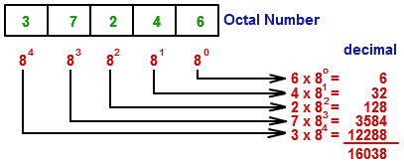
Octal
Octal is base 8 and works as decimal, hex, and binary and is left as an exercise to the student….

Slide 25
Converting: Decimal to Binary
Algorithm to convert integer n to binary:
String result = “”;
while (n>0)
result = (n%2)+result
n=n/2
https://interactivepython.org/runestone/static/pythonds/BasicDS/ConvertingDecimalNumberstoBinaryNumbers.html

Slide 26
General Conversion Algorithm
Identify the digit set of original and the value of each digit.
Identify the value of each place.
Multiply the digit value by its place value.
Sum values from step 3.

Slide 27
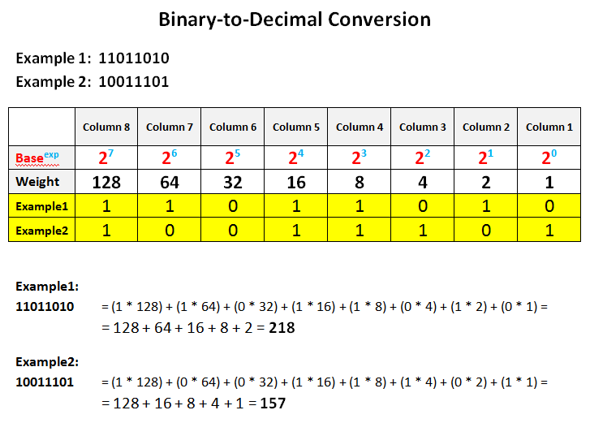
Converting: Binary to Decimal

Slide 28
Converting: Decimal to Hex
Algorithm to convert integer n to hexadecimal
String result = “”;
while (n>0)
result = hexdigit((n%16))+result
n=n/16
Note: hexdigit(int d)returns the proper hex digit [0..9,A..F] for the remainder value

Slide 29
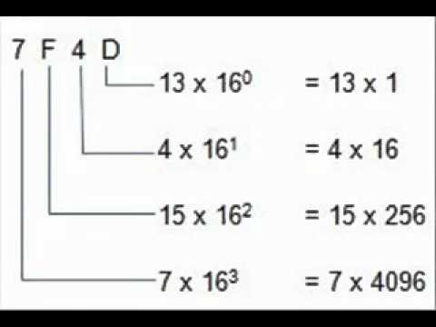
Converting: Hex to Decimal
Multiply the digit value by its place value and sum:
32,589_{D}

Slide 30
Converting Binary to Hex
Each set of 4 bits represents 0-15
Each Hex digit is a value from 0-15
Divide the string of bits into nibbles.
Convert each nibble to its Hex counterpart.
Ex. 10110110
1011 0110
10110110_{B} = B6_{H}
Decimal 6 = Hex 6= B
Decimal 11 = Hex B = B

Slide 31
Converting: Binary to Hexadecimal
To convert Binary to Hexadecimal, break the binary number down into nibbles
1.Split into Nibbles: 1101_{B} 0110_{B}
2. Convert to Decimal: 13_{D} 6_{D}
3. Translate to Hex Digits: D_{H} 6_{H}
1101010_{B} = D6_{H}

Slide 32
Converting: Hex to Binary
Convert each Hex digit to a nibble. You may wish to first convert the Hex to Decimal, then Binary . Once you become proficient, you won’t need the decimal step.
Hex: 4 D 6 F
Decimal: 4 13 6 15
Binary: 0100 1101 0110 1111
4D6F_{H} = 0100110101101111_{B}

Slide 33
Exercises
Get together in groups of 2 and convert the following:
10101101_{B} to Decimal
11010010_{B} to Hex
4AB2_{H} to Binary
D5_{H} to Decimal
198_{D} to Binary
267_{D} to Hex

Slide 34
Adding Unsigned Binary Numbers
Carry operations occur just as when we are adding in decimal:
1 1 ←Carry
1 1 0 1
+ 0 1 1 0
1 0 0 1 1
https://www.cs.umd.edu/class/sum2003/cmsc311/Notes/BinMath/addUB.html

Slide 35
Representing Negative Numbers in Binary
A restriction thus far is that we are only representing positive integers.
How do we represent negative numbers in binary keeping in mind we will eventually implement this representation in hardware?

Slide 36
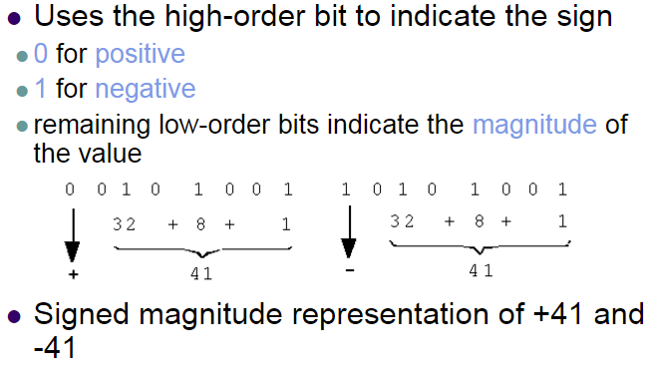
Early Representations – Sign/Magnitude
http://slideplayer.com/slide/5946572/

Slide 37
Sign/Magnitude Limitations
1. Adding the representations for + and – 41 does not result in zero:
1 1 1
0 0101001
+1 0101001
1 1010010 = ?? Not zero!
2. 10000000 and 00000000 : Two zeroes! No!
3. Wasting an entire bit on sign

Slide 38
One’s Complement
Another representation of negative numbers is the “One’s Complement”
This method has limitations both in amount of values represented and complexity of the circuitry required.
We will not discuss One’s Complement, however a good discussion is provided here: http://www.programminglogic.com/how-computers-represent-negative-binary-numbers/

Slide 39
A Better Way – Two’s Complement
Leading 0’s mean positive
Leading 1’s mean negative
This also makes hardware easy to implement.
Most Supremely Excellent Reference:
http://www.tfinley.net/notes/cps104/twoscomp.html

Slide 40
Calculate Two’s Complement
To negate a positive binary number
OR
To make a negative binary positive
Complement bits
Add 1

Slide 41
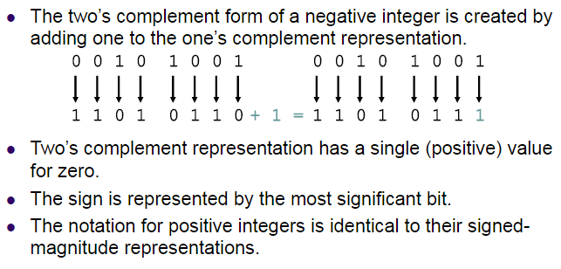
Two’s Complement
http://slideplayer.com/slide/5946572/

Slide 42
Uneven Two’s Complement
There is one more negative than positive number, to account for 0.
Range for Two’s Complement:
-2^{n-1} to 2^{n-1} -1
Range for 32 bit Two’s Complement:
-2,147,483,648 to 2,147,483,647

Slide 43
Some notes on 2’s complement
The leading digits indicate the sign.
Assuming 2’s complement representation:
1110101 is a negative b/c of leading 1’s
0000101 is a positive b/c of leading zeros
To find value of a 2’s complement, apply algorithm:
1110101 ←original What is value?
0001010 ← invert
+1
0001011

Slide 44
Some notes on 2’s complement
To find it’s value in 2’s complement, we add a leading 1 to indicate sign.
1011 = 11
0100+1 = 0101…but it has a leading zero!
We add a leading one to show this is a 2’s complement negative: 10101

Slide 45
Two’s Complement Range in n bits?
Review:
In two’s complement, the lead bit is the sign indicator.
For a small example, let’s consider 4 bits: Range [0,2^{n}-1]
for an unsigned
13 decimal integer.
3 | 2 | 1 | 0
1 | 1 | 0 | 1

Slide 46
Two’s Complement Range in n bits
The leftmost bit is the
sign indicator.
To find the decimal equivalent, two’s complement the number:
1101 0010 0011= -3₁₀
Losing the leftmost bit takes 2n out of the total. Range is
3 | 2 | 1 | 0
1 | 1 | 0 | 1
complement bits
add 1

Slide 47
Working with Signed Binary Numbers
Exercises:
Get together in groups of two and do the following in binary using two’s complement representation:
36-8
-63-9
16+23

Slide 48
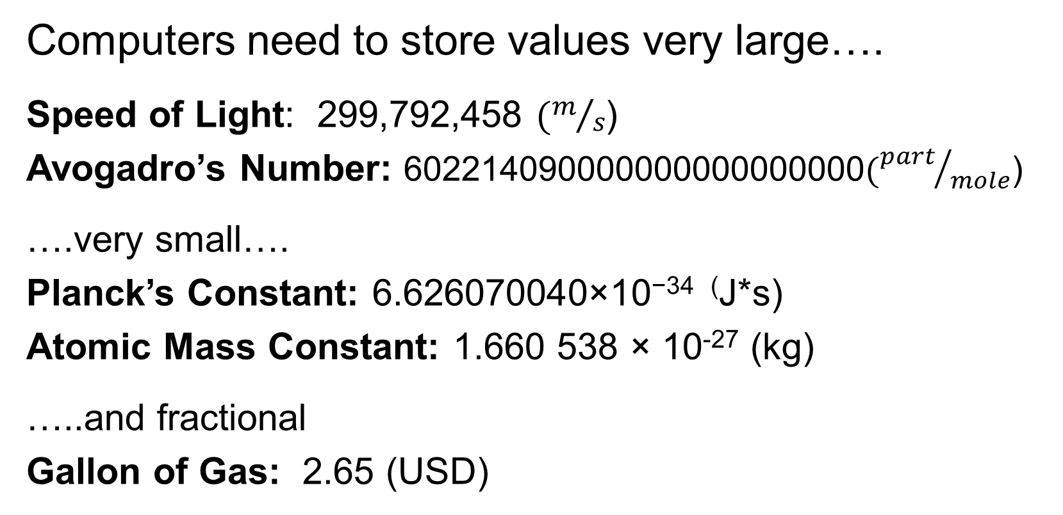
Representing Large, Small, Fractional
Computers need to store values very large….
Speed of Light: 299,792,458 $(m/s$)
Avogadro’s Number: 602214090000000000000000$({part}/{mole}$)
….very small….
Planck’s Constant: 6.626070040×10⁻³⁴ ⁽J*s)
Atomic Mass Constant: 1.660 538 × 10⁻²⁷ (kg)
…..and fractional
Gallon of Gas: 2.65 (USD)
http://floating-point-gui.de/formats/fp/

Slide 49
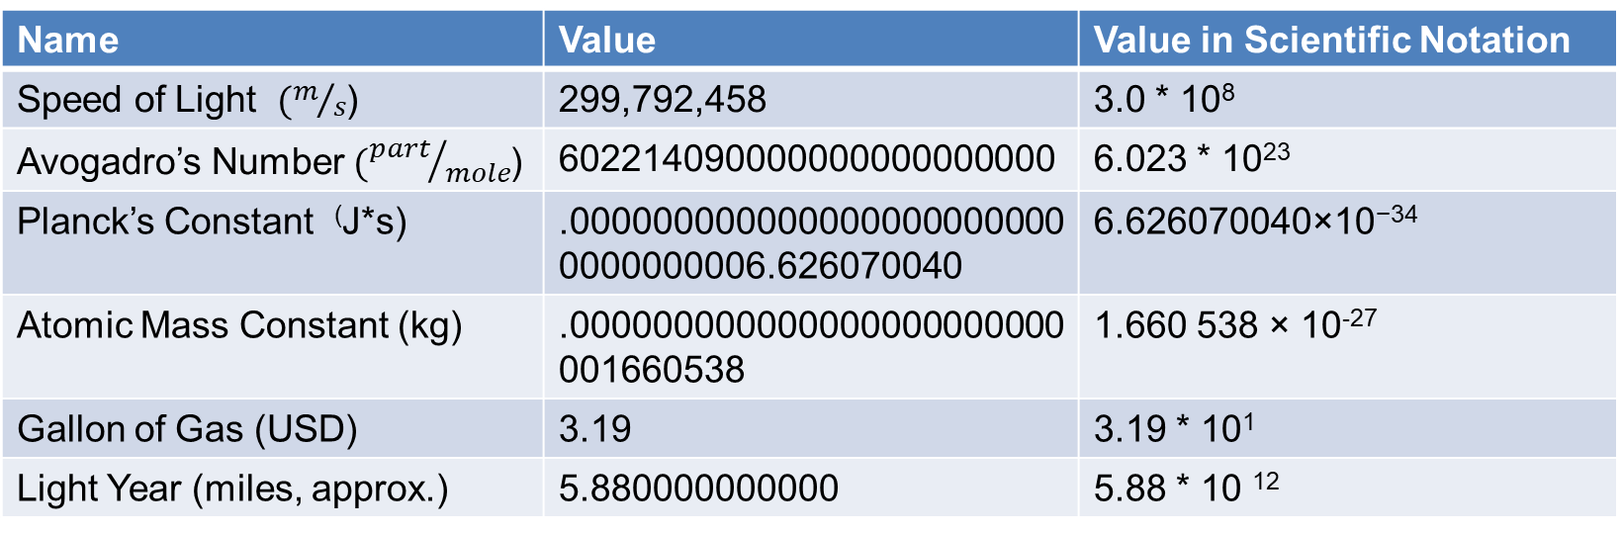
Scientific Notation
Name | Value | Value in Scientific Notation
Speed of Light $(m/s$) | 299,792,458 | 3.0 * 10⁸
Avogadro’s Number $({part}/{mole}$) | 602214090000000000000000 | 6.023 * 10²³
Planck’s Constant ⁽J*s) | .0000000000000000000000000000000006.626070040 | 6.626070040×10⁻³⁴
Atomic Mass Constant (kg) | .000000000000000000000000001660538 | 1.660 538 × 10⁻²⁷
Gallon of Gas (USD) | 3.19 | 3.19 * 10¹
Light Year (miles, approx.) | 5.880000000000 | 5.88 * 10 ¹²

Slide 50
Precision
The number of digits we use in our calculations indicate precision. 3.14 has less precision than 3.1415
Do we have to use as many values past the decimal point as possible?
Depends on your significant figure scheme.

Slide 51
Accuracy vs Precision
Accuracy: Number of digits past the decimal point
Precision: Total number of digits

Slide 52
Representing Floating Points
To represent these values in the most efficient way, we represent them differently. We split the number into two parts:
Significand: The digits of the value
Exponent: Denotes placement of the decimal
Sign: 1 Bit: 1 for negative, 0 for positive

Slide 53
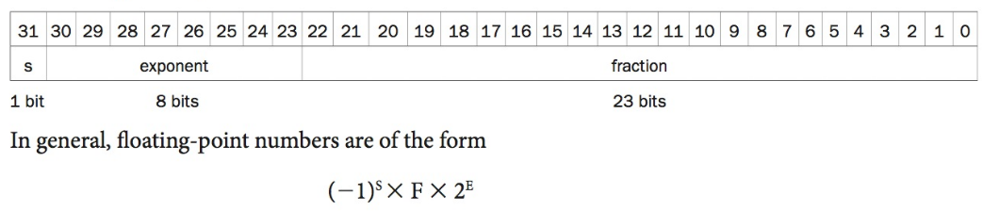
Floating Point – IEEE 754
MIPS representation

Slide 54
Why that order?
The order of the fields: Sign, Exponent, Fraction
Why do you think they are in that order?
Comparison! First we compare sign, then the exponent then the fraction.

Slide 55
New Error!
We talked about overflow with unsigned values where the value we wish to represent is larger than the capacity allowed by the number of bits. This can also happen with floating point values.
Underflow occurs when a fraction is so small the exponent cannot be expressed in the number of bits allotted in the floating point format.

Slide 56
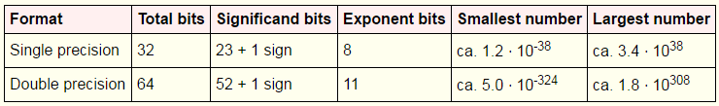
Solving Under and Overflow Double Precision
This format is why when you declare a variable of type “double” it has a wider range of values than an integer. This will only solve the problem as long as you don’t overflow a double
Question: Why are most for loop indexes of type int?

Slide 57
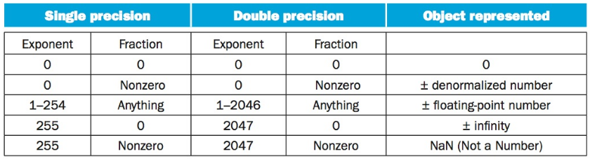
Representing Special Values
An assumed 1 means we have to have a special representation for 0.

Slide 58
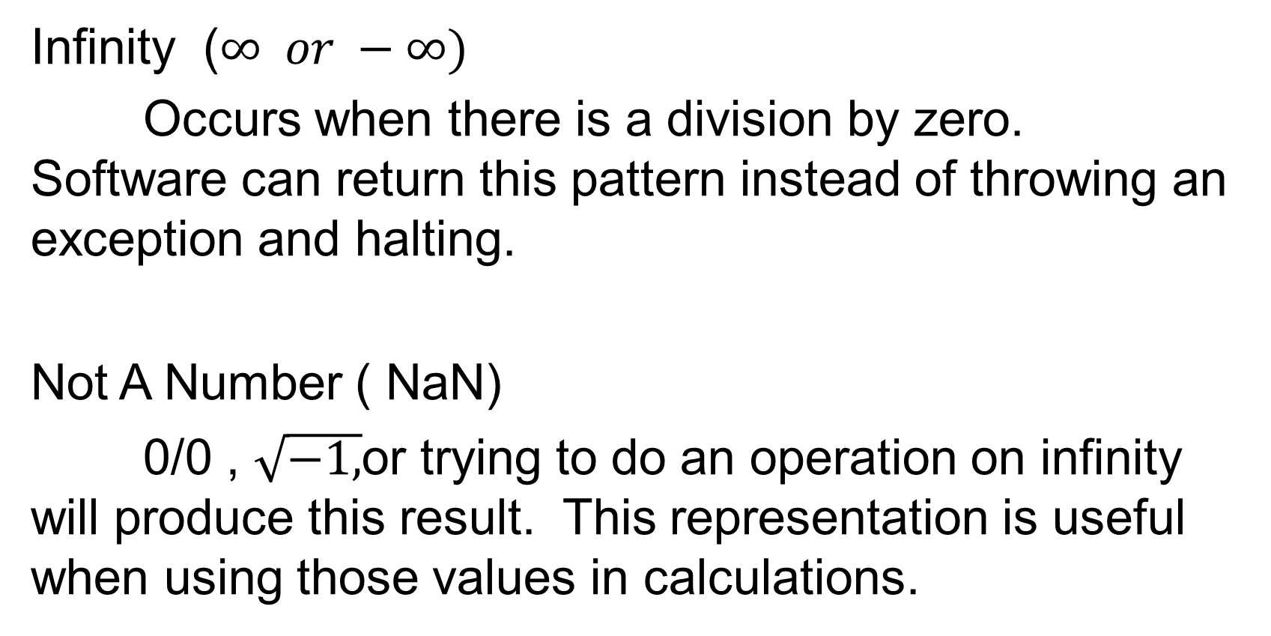
Special Values
Infinity ($∞ or −∞)$
Occurs when there is a division by zero. Software can return this pattern instead of throwing an exception and halting.
Not A Number ( NaN)
0/0 , $\sqrt{−1,}$or trying to do an operation on infinity will produce this result. This representation is useful when using those values in calculations.

Slide 59
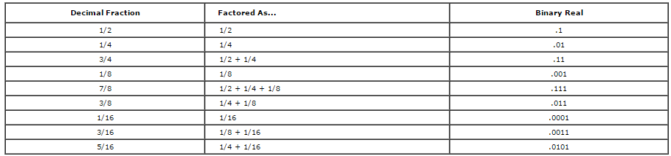
A useful table:
http://kipirvine.com/asm/workbook/floating_tut.htm

Slide 60
A look at binary scientific notation:
1.01111 * 2²
mantilla
exponent
Assumed

Slide 61
Getting more out of our space: Normalizing
Value Normalized Exponent
1101.101 1.101101 3
.00101 1.01 -3
1.00001 1.00001 0
1000001.11 1.00000111 6
What is in common between the normalized values?
How can we use this to be more efficient?
What is a restriction?

Slide 62
Biased Notation
We said that we store the exponent ahead of the fractional part for comparison reasons…..

Slide 63


Negative Exponents and Comparisons
Why are the fields in the Floating Point format in the order sign, exponent, fraction?
So… say, we have two positive single precision floats with the following exponents:
Which is larger? Left or Right?

Slide 64
Comparing Exponents in FP
The one on the right!
We represent the values in two’s complement:
-1 1

Slide 65
Comparing Exponents in FP
To make comparison easier, exponents are stored in biased notation .
Biased notation adds a value to the exponent so that the most negative exponent is represented as all 0’s and the most positive as all 1’s
Consider this a “shift” of the values

Slide 66
Biased Exponent Example
IEEE 754 uses 127 bias for single precision and 1023 for double
-1 exponent is represented by bit pattern for -1+ bias
So that would be the bit pattern for 126₁₀ which would be 01111110₂

Slide 67
Converting from Decimal to Binary FP

Slide 68
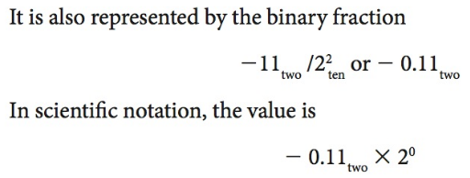
Converting – First, Powers of 2

Slide 69
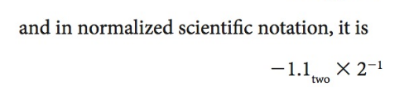
Converting: Normalizing

Slide 70
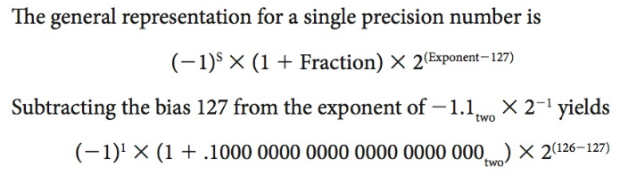
Converting: Adding the bias

Slide 71
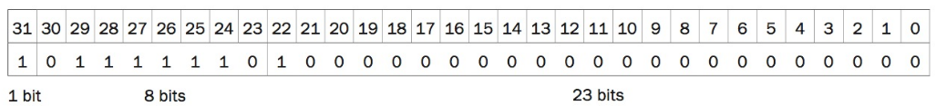
Finally:

Slide 72
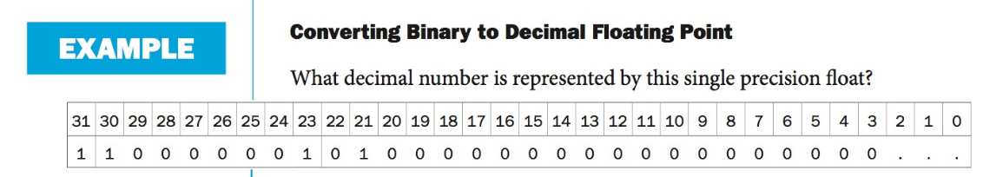
Your Turn!

Slide 73
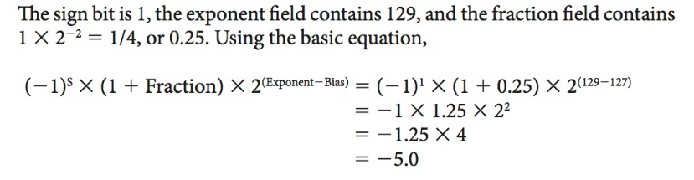
Solution

Slide 74

Topics to explore later in semester…
What happens when we exceed the max capacity for the number of bits allowed by the architecture?
Are integers and floats handled the same in hardware?
How do we add, subtract, divide?

